Slide 1

DBS Data Analysis
Comprehensive Insights into Bank Transactions

Slide 2
Introduction
This presentation covers the detailed analysis of DBS Bank’s credit and debit transaction data.
The focus is on understanding customer spending patterns, branch performance, and transaction trends to support strategic business decisions and operational improvements.

Slide 3
01
Project
Overview

Slide 4
Objective and Impact
The project aims to analyze transaction data to reveal insights about customer behavior and account performance.
The key goal is to identify high-performing branches and transaction trends that drive better business decisions and enhance customer engagement.

Slide 5
Team Members
Shravani Dhuri
Purva Dhote
Vrushali Awari
Shivanjali Ahiwale
Nayan Kumar
Rushikesh Pochhi
Saba Attar

Slide 6

Key Performance Indicators (KPIs)
The analysis tracks several crucial KPIs including total transaction amounts, average transaction value, and number of transactions per branch.
Additional metrics such as customer activity ratio and identification of top-performing branches help measure both operational efficiency and customer engagement.
These KPIs support targeted business decisions and performance benchmarking.

Slide 7
Key Metrics Summary
Overview of Transactions, Risk Operations

Slide 8
01
Transaction
Overview

Slide 9
Total Transactions Processed
The total number of transactions processed reached 100,000, reflecting the overall activity level.

Slide 10

Credit vs Debit Transactions
Credit transactions slightly outnumber debit ones with 50,028 inflows versus 49,972 outflows.
This close balance indicates a stable customer spending and deposit pattern, crucial for maintaining liquidity and operational stability.

Slide 11
Transaction Distribution Insights
The distribution of transactions is almost evenly split among the main payment channels: Bank Transfer (33.34%), Credit Card (33.31%), and Debit Card (33.35%).
This balanced distribution reflects diverse customer preferences and strategic channel utilization, an important factor for optimizing transaction processing and customer outreach.

Slide 12
02
Risk and Operational
Metrics

Slide 13

Risky Customer and Suspicious Transactions
A total of 4,239 customers have been flagged as risky, indicating potential exposure to fraud or non-compliance.
Additionally, 40,796 transactions were identified as suspicious with high-risk indicators, highlighting the critical need for robust monitoring and security protocols to mitigate financial risks.

Slide 14
High Debit Customer Activity
There are 40,796 customers exhibiting high debit activity, which may suggest increased spending or withdrawal behaviors.
Monitoring this segment is essential to identify unusual patterns, manage liquidity, and prevent potential abuse or fraudulent activity within operational parameters.

Slide 15
Payment Method Volume Breakdown
Transaction volumes across payment methods are highly consistent: 33,338 via Bank Transfer, 33,310 Credit Card transactions, and 33,352 Debit Card transactions.
This equivalence suggests a well-diversified transaction portfolio, enabling balanced risk exposure and operational flexibility across payment channels.

Slide 16
02
Data Analysis and
Visualization

Slide 17

Excel Dashboard Insights and Tools
The Excel dashboard features branch-wise total and average transaction trends alongside the distribution of debit versus credit transactions.
Monthly spending patterns and growth trends are highlighted using pivot tables, charts, and conditional formatting to provide a clear view of transaction dynamics across branches.

Slide 18
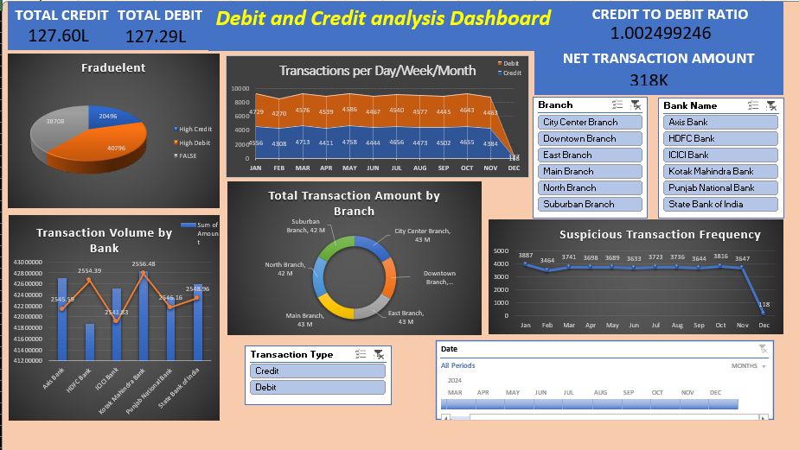

Slide 19
Tableau Visualizations and Customer Trends
Tableau visualizations present branch performance on maps, showing customer activity ratios and monthly transaction trends.
It also identifies top customers by their transaction value.
These visual insights help pinpoint high-value clients and regional performance variations for strategic planning.

Slide 20
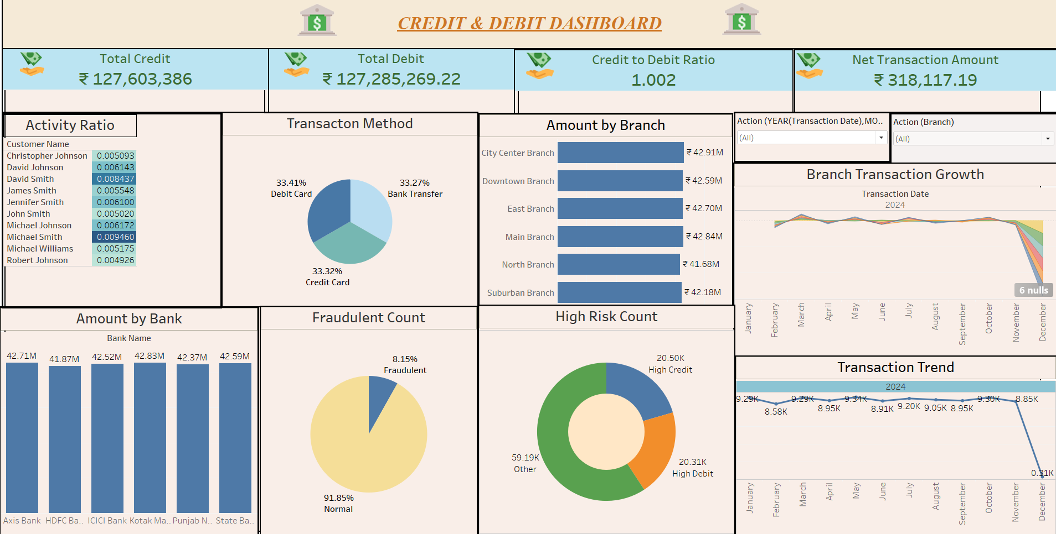

Slide 21
Power BI Interactive Analysis and Monitoring
Power BI dashboards offer advanced interactive features, including drill-through analysis of transactions and real-time KPI monitoring.
This enables dynamic performance tracking at the branch level, facilitating timely decision-making and continuous operational improvements.

Slide 22
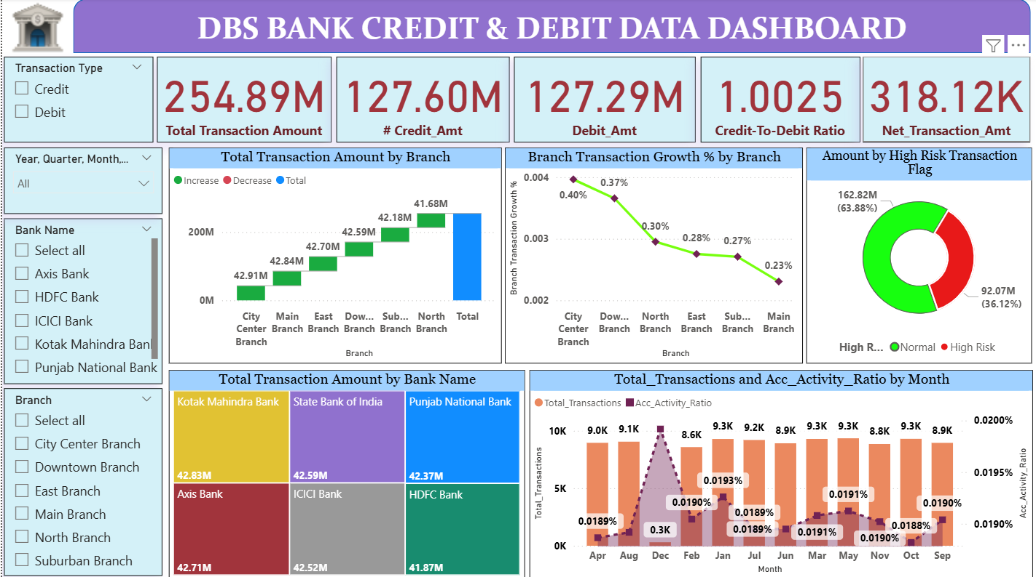

Slide 23
SQL Queries
SQL databases provide robust data management for banking systems, enabling secure storage, retrieval, and manipulation of financial records.

Slide 24
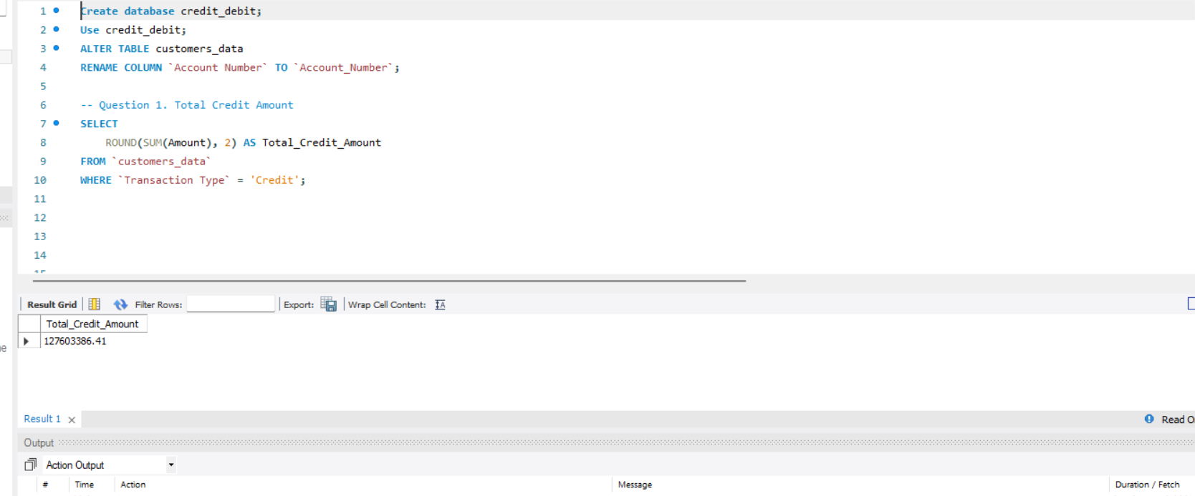
SQL Query for displaying Total Credit Amount:
Query:
SELECT ROUND(SUM(Amount), 2) AS Total_Credit_Amount
FROM `customers_data` WHERE `Transaction Type` = 'Credit’;
Output:

Slide 25
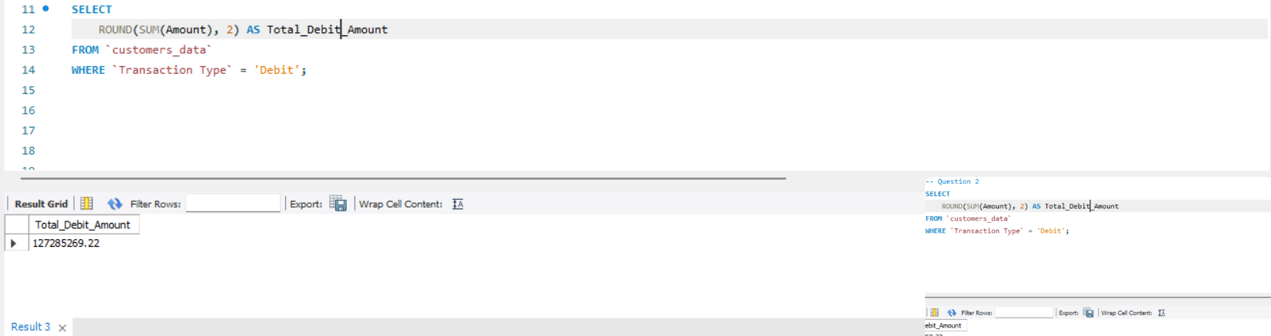
SQL Query for displaying Total Debit Amount:
Query:
SELECT ROUND(SUM(Amount), 2) AS Total_Debit_Amount
FROM `customers_data` WHERE `Transaction Type` = 'Debit’;
Output:

Slide 26
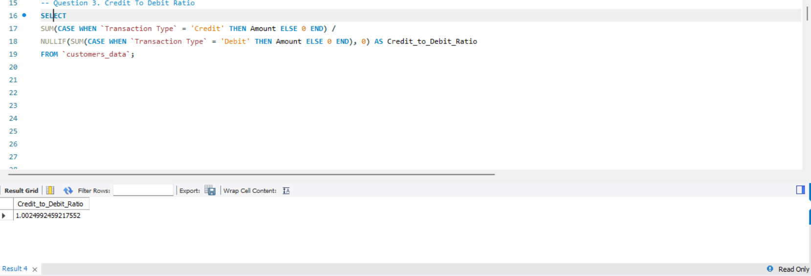
SQL Query for displaying Credit To Debit Ratio:
Query:
SELECT SUM(CASE WHEN `Transaction Type` = 'Credit' THEN Amount
ELSE 0 END) /NULLIF(SUM(CASE WHEN `Transaction Type` = 'Debit’
THEN Amount ELSE 0 END), 0) AS Credit_to_Debit_Ratio FROM `customers_data`;
Output:

Slide 27
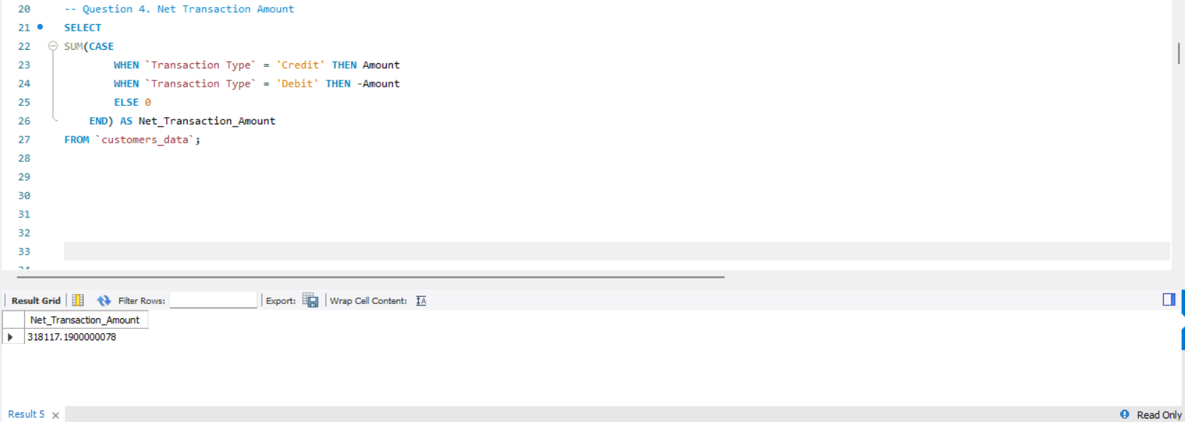
SQL Query for displaying Net Transaction Amount:
Query:
SELECT SUM(CASE WHEN `Transaction Type` = 'Credit' THEN Amount
WHEN `Transaction Type` = 'Debit' THEN –Amount ELSE 0 END) AS
Net_Transaction_Amount FROM `customers_data`;
Output:

Slide 28
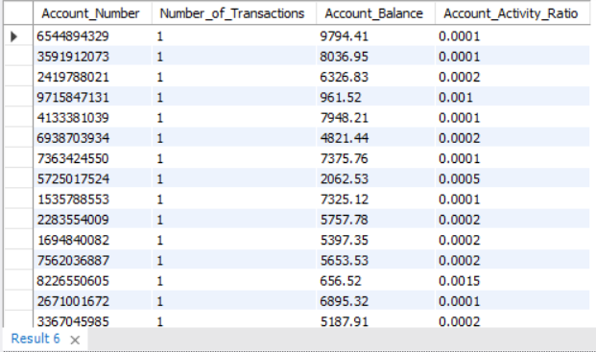
SQL Query for displaying Account Activity Ratio:
Query:
SELECT Account_Number, COUNT(*) AS Number_of_Transactions,
MAX(Balance) AS Account_Balance, ROUND(COUNT(*) / MAX(Balance),4) AS Account_Activity_Ratio FROM customers_data GROUP BY Account_Number;
Output:

Slide 29
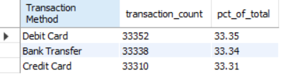
SQL Query for displaying Transaction Method Distribution
Query:
SELECT t.`Transaction Method`, t.cnt AS transaction_count, ROUND(100 * t.cnt /
NULLIF(s.total_count, 0), 2) AS pct_of_total FROM ( SELECT `Transaction Method`, COUNT(*) AS
cnt FROM `customers_data` GROUP BY `Transaction Method`) AS t CROSS JOIN ( SELECT
COUNT(*) AS total_count FROM `customers_data`) AS s ORDER BY t.cnt DESC;
Output:

Slide 30
Conclusions
The data analysis revealed that top branches contribute significantly to total transaction volumes, with metropolitan areas showing higher credit activity.
Weekend transaction volumes increase by approximately 20%.
Challenges include data inconsistencies and missing values, prompting recommendations for automation and predictive analytics to enhance future reporting and decision-making.

Slide 31
Thanks!

